Slide 1

Social Determinants of Health and Diabetes in Virginia
March 23, 2020
Jamie Chamberland, Lillian Gotberg,
Ian Oommen, and Laura Williams
Notes:
Jamie

Slide 2
OVERVIEW
Background
Methodology
Findings
Q&A
Notes:
Jamie

Slide 3


1
Diabetes in Virginia
Notes:
Jamie

Slide 4
Background
In 2015, more than 5 million Virginians were estimated to have at least one chronic condition. Over 2 million had two or more chronic conditions.
Chronic diseases are the leading cause of death in Virginia, 50% of which are estimated to be avoidable.
The state cost of chronic conditions is expected to exceed $1 trillion between 2016-2030.
Source: Virginia Department of Health. (n.d.). Chronic Diseases in Virginia. Retrieved from http://www.vdh.virginia.gov/content/uploads/sites/65/2017/05/chronic-disease_10206544_1e301354434e35fe46d3afe1be1302da945417c1.pdf
Notes:
Ian

Slide 5
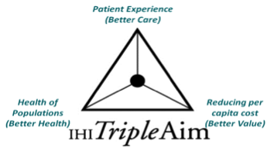
Why Focus on Diabetes?
Notes:
Ian

Slide 6
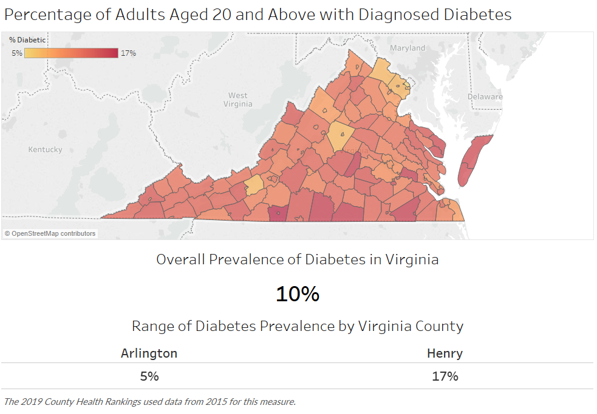
Diabetes Prevalence in Virginia
Min
Max
Notes:
Ian

Slide 7
Key Questions for Virginia:
What are the characteristics of counties/cities with a high prevalence rate for diabetes?
What geographic areas have a disproportionate rate of diabetes?
Can identified patients be connected to resources to better coordinate their care?
Notes:
Ian

Slide 8
2
Methodology
Notes:
Ian

Slide 9
Data Source
Robert Wood Johnson Foundation County Health Rankings
Measures:
Timeframe: 2019
Notes:
Ian

Slide 10




Methodology Steps
Extract
County Health Data
Build visualizations and analyze data
Export output and share findings
Import data into Jupyter Notebook
Notes:
Ian

Slide 11
3
Findings

Slide 12
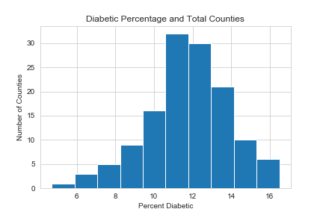
All Virginia Counties:
Total Number of Counties by % Diabetes
Notes:
Ian

Slide 13
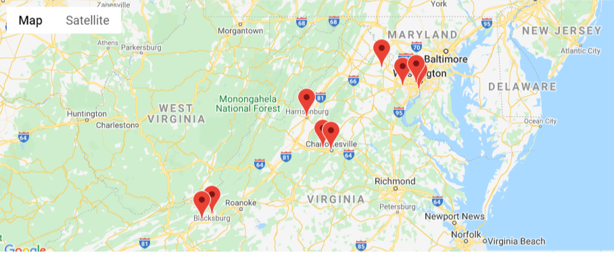
Top Counties/Cities with the Lowest Rate of Diabetes
Notes:
Jamie

Slide 14
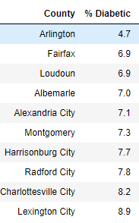


Slide 15
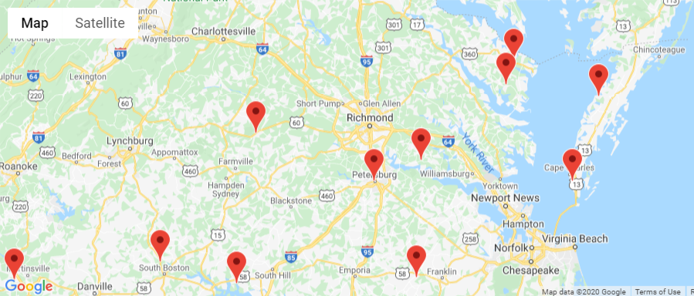
Top Counties/Cities with the Highest Rate of Diabetes
Notes:
Jamie

Slide 16
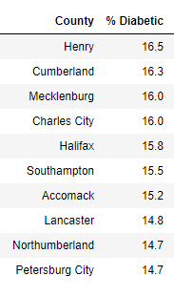


Slide 17
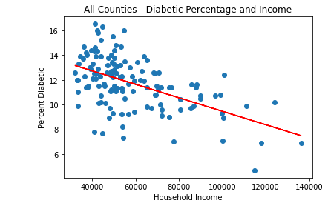
All Virginia Counties:
% Household Income
Notes:
Jamie - economic well being (income)

Slide 18
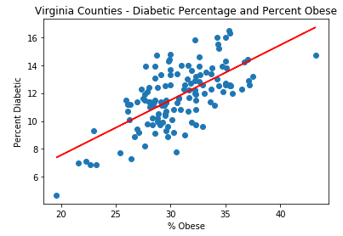
All Virginia Counties:
% Obese
Notes:
Laura - health outcome (obesity)

Slide 19
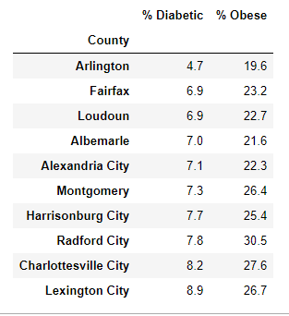
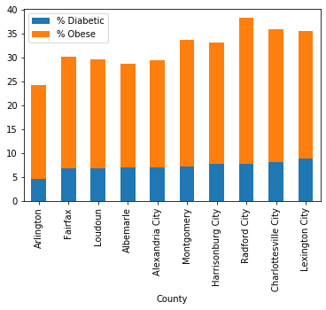
Lowest % Diabetic Counties:
% Obesity
Notes:
Laura

Slide 20
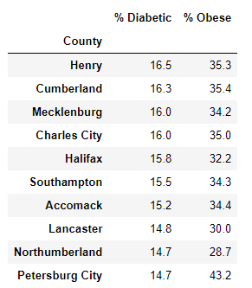
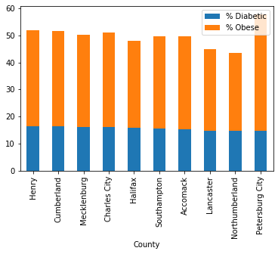
Highest % Diabetic Counties:
% Obesity
Notes:
Laura

Slide 21
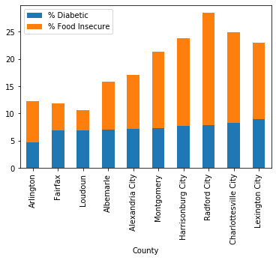

Lowest % Diabetic Counties:
% Food Insecure
Notes:
Laura

Slide 22
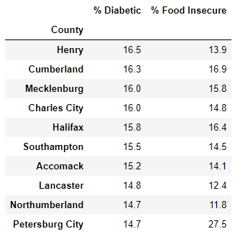
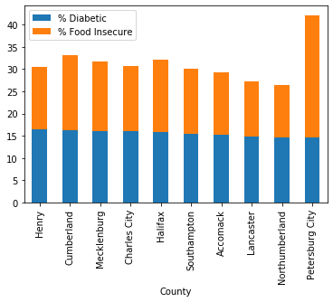
Highest % Diabetic Counties:
% Food Insecure
Notes:
Laura

Slide 23
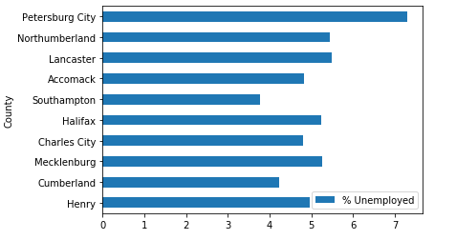
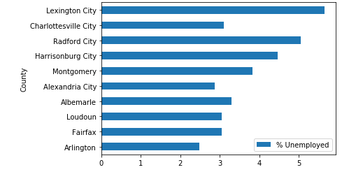

Slide 24
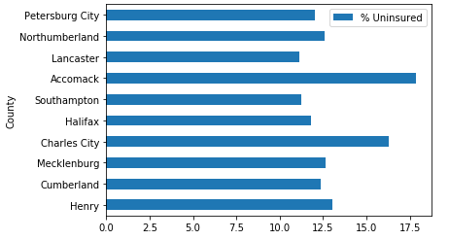
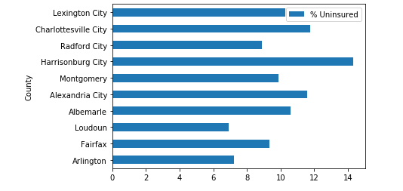

Slide 25
Future Analyses and Next Steps
Locate community resources and programs like the YMCA and plot on maps
Pull CDC data on Deaths related to diabetes and heart health

Slide 26
Questions?

